Slide 1

第十章 不确定性的量化
Notes:
Welcome to NExT. NExT is a joint research centre setup between NUS and Tsinghua University of China. The aim is to carry out research on extreme search on user-generated social network contents.

Slide 2
内容提要
不确定性概述
基本概率符号
条件独立性
贝叶斯规则和分类

Slide 3

逻辑理论与概率理论
逻辑Agent相信每个语句是正确的或者错误的，不做评价
概率Agent为每个语句赋予一个0到1之间的数值作为其信念度
例如：牙疼 牙洞80%的可能性。
如何获得这一概率？从样本数据中统计获得
$$⇒$$
Notes:
But just how big these UGCs are. On average, in every 60 seconds in social media, two million videos are viewed on YouTube, 700,000 messages are delivered by way of Facebook, 175,000 tweets are fired off into the ether, and 2,000 Foursquare check-ins tell the world where we are. When considered together, one thing seems clear: social media has taken over the world.

Slide 4
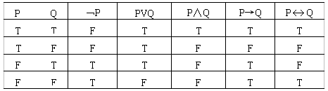
基本概率符号
样本空间( )：所有可能世界组成的集合
互斥的
完备的

Slide 5
基本概率符号
样本空间( )：所有可能世界组成的集合
互斥的：每个事件间相互独立
完备的
概率模型：为每一个可能世界附一个数值概率p(w)
样本空间中的所有可能世界的总概率是1
事件(event):样本空间中的可能世界集合

Slide 6
基本概率符号
基本元素：随机变量
大写字母开头，e.g. Total: 掷两个骰子的点数
定义域：变量所有可能值组成的集合
e.g. Total的定义域{2,…,12}
e.g. 布尔变量定义域{true,false}
A=true简写成a, A=false简写成﹁a

Slide 7
基本概率符号
离散变量 vs.连续变量
原子命题 vs.复杂命题
原子命题通过对随机变量赋值得到的命题，比如Weather = sunny, Cavity = false
复杂命题指原子命题通过连接符号连接而成的命题Weather = sunny ∨ Cavity = false
概率理论对命题给定信任度值
e.g. P(cavity| ﹁toothache ∧teen)=0.1

Slide 8
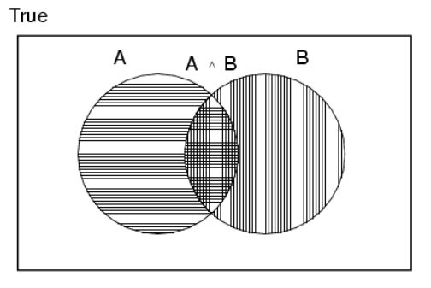
概率公理
对于任何命题A,B
0 ≤ P(A) ≤ 1
P(true) = 1 and P(false) = 0
P(A ∨ B) = P(A) + P(B) - P(A ∧ B)

Slide 9
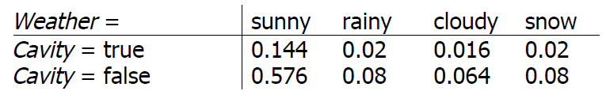
先验概率
先验概率又称无条件概率（不考虑其它因素）
P(Cavity = true) = 0.1, P(Weather = sunny) = 0.72
概率分布对于所有可能的随机变量赋予概率值
P(Weather) = <0.72, 0.1, 0.08, 0.1>
所有可能事件的概率值之和为1
联合概率分布对多个随机变量中的每个变量发生的可能性进行概率赋值

Slide 10
条件概率
条件概率又称为后验概率
P(cavity | toothache) = 0.8
如果我们已经知道cavity发生了，那么我们能够推断
P(cavity | toothache, cavity) = 1
当新的事件是无关的时候，可以进行简化
P(cavity | toothache, sunny) //sunny 和cavity 无关
= P(cavity | toothache)
= 0.8

Slide 11
条件概率
条件概率的定义：
P(a | b) = P(a ∧ b) / P(b) if P(b) > 0
譬如：P(Weather, Cavity)
= P(Weather | Cavity) P(Cavity)
运用乘法规则我们得到另一种表示形式
P(a ∧ b) = P(a | b) P(b) = P(b | a) P(a)

Slide 12

条件概率
根据链式推导规则我们可以得到:
$$P\left(X_{1},...,X_{n}\right)$$
$$=P(X_{1},...,X_{n−1})P(X_{n}|X_{1},...,X_{n−1}) \\ =P\left(X_{1},...,X_{n−2}\right)P\left(X_{n−1} | X_{1},...,X_{n−2}\right)P\left(X_{n} | X_{1},...,X_{n−1}\right)$$
$$=.....$$
$$=∏_{i=1}^{n}P(X_{i}|X_{1},...,X_{i−1})$$

Slide 13
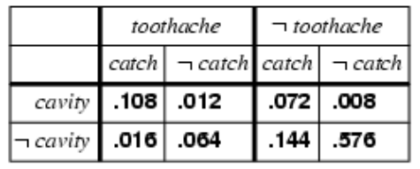

例子：牙病问题

Slide 14
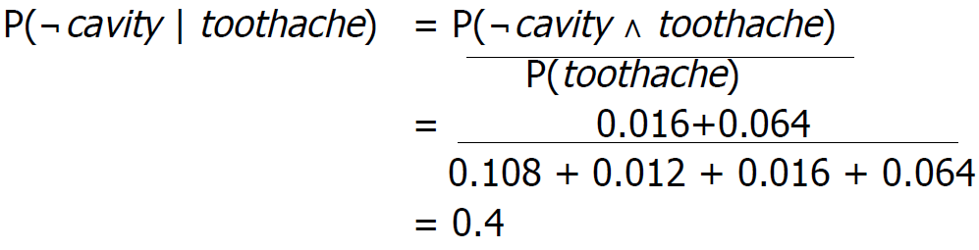
例子：牙病问题

Slide 15
归一化
目 标：给定条件变量E的值e, 计算查询变量Y的后验联合分布P(Y|E=e).
步 骤：
确定隐藏变量H=X-E-Y, 其中X是变量总集
P(Y | E = e)
= α P(Y, E = e)
= α Σ_{h}P(Y, E= e, H = h)
= α [P(Y, E= e, H = h) + P(Y, E= e, H = ﹁ h) ]

Slide 16
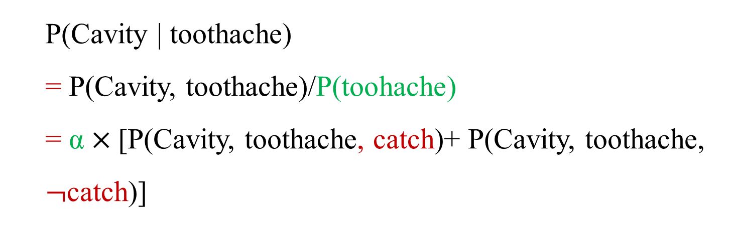
归一化
P(Cavity, toothache)=P(toothache) $×$P(Cavity | toothache)
P($¬$Cavity, toothache)=P(toothache) $×$P($¬$Cavity | toothache)
P(Cavity | toothache)
= P(Cavity, toothache)/P(toohache)
= α $×$[P(Cavity, toothache, catch)+ P(Cavity, toothache, $¬$catch)]
隐藏变量catch

Slide 17
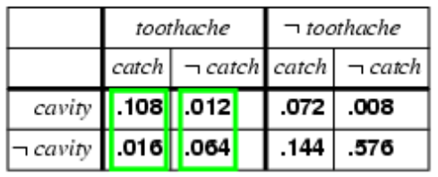
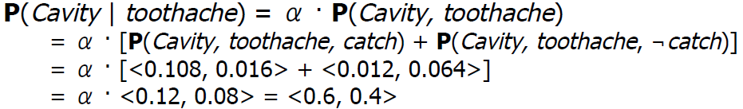
归一化
P(toothache)无法估计时同样可以计算概率P(Cavity | toothache)
归一化，同时除以0.12+0.08
α =1/ 0.12+0.08

Slide 18
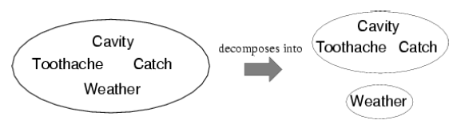
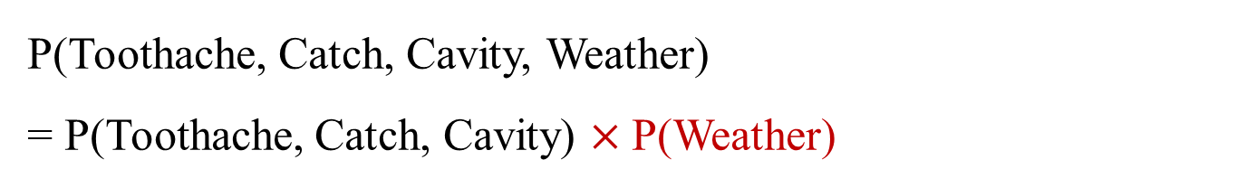
独立性
命题a和b之间的独立性可以写作：
$$P(b|a)=P(b) P(a|b)=P(a) P(a∧b)=P(a)P(b)$$
P(Toothache, Catch, Cavity, Weather)
= P(Toothache, Catch, Cavity) $×$P(Weather)

Slide 19
条件独立性
如果我有一个牙洞，钢探针能够触摸到catch的概率不依赖于牙疼toothache
P(catch |toothache, cavity)=P(catch|cavity)
同样，如果没有牙洞，钢探针能够触摸到的概率也不依赖于牙疼
P(catch | toothache, ¬cavity)=P(catch|¬cavity)
钢探针能否触摸到是条件独立于牙洞的
P(catch | toothache, cavity)=P(catch|cavity)
catch与toothache相互独立

Slide 20
贝叶斯规则
联合概率规则
P(A∧B) = P(A| B) P(B) = P(B | A) P(A)

Slide 21
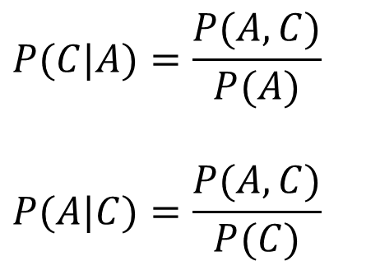
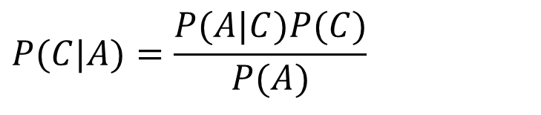
贝叶斯分类器
一个用于解决分类问题的概率框架
条件概率:
Bayes定理:
$$P(C|A)=\frac{P(A,C)}{P(A)}$$
$$P(A|C)=\frac{P(A,C)}{P(C)}$$
$$P(C|A)=\frac{P(A|C)P(C)}{P(A)}$$

Slide 22
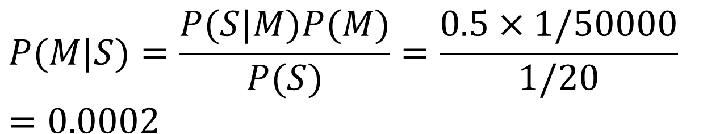
贝叶斯定理举例
给定:
50%的脑膜炎患者M脖子僵硬S
人得脑膜炎M的概率是1/50,000
脖子僵硬的人S的概率是 1/20
若某个患者脖子僵硬S, 则他患脑膜炎M的概率是多少?
$$P(M|S)=\frac{P(S|M)P(M)}{P(S)}=\frac{0.5×1/50000}{1/20}=0.0002$$

Slide 23
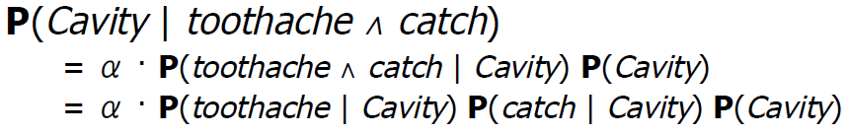
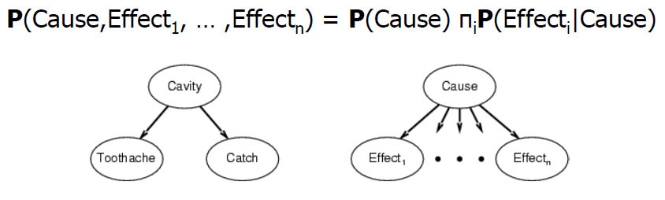

贝叶斯规则
利用条件独立性和贝叶斯规则简化问题
朴素贝叶斯
省去了计算P(Toothache$∧$Catch)

Slide 24
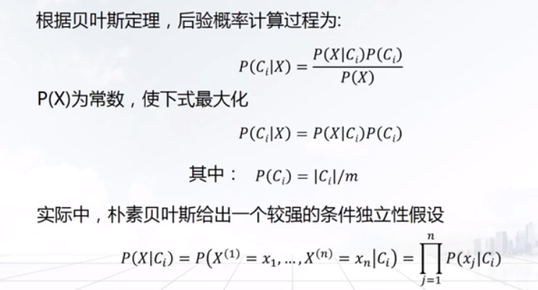
贝叶斯分类
（分类特征间都是独立的！）
α

Slide 25
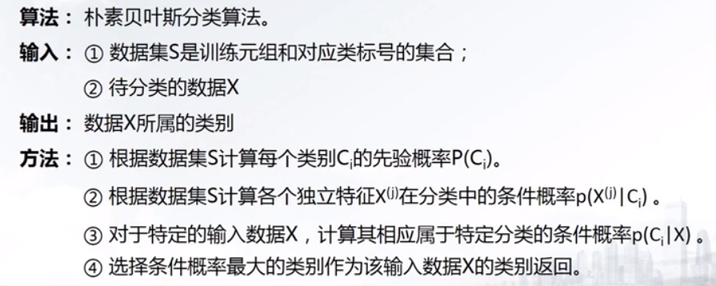
贝叶斯分类

Slide 26
贝叶斯分类
类别:
C1: buys_computer = ‘yes’
C2: buys_computer = ‘no’
待预测数据：
X = (age <=30,
Income = medium,
Student = yes
Credit_rating = Fair)
2021年12月28日星期二
26
Notes:
26

Slide 27

贝叶斯分类
--计算$先验概率P(Ci)$
X=(age<=30, income=medium, student=yes, credit_rating= fair)
P(C_{i}): P(buys_computer = “yes”) = 9/14 = 0.643
P(buys_computer = “no”) = 5/14= 0.357
Notes:
27

Slide 28

贝叶斯分类
--计算$条件概率P(Xi|Ci)$
X=(age<=30, income=medium, student=yes, credit_rating= fair)
P(C_{i}): P(buys_computer = “yes”) = 9/14 = 0.643
P(buys_computer = “no”) = 5/14= 0.357
Compute P(X|C_{i}) for each class
P(age = “<=30” | buys_computer = “yes”) = 2/9 = 0.222
P(age = “<= 30” | buys_computer = “no”) = 3/5 = 0.6
Notes:
28

Slide 29

贝叶斯分类
--计算$条件概率P(Xi|Ci)$
X=(age<=30,income=medium,student=yes,
credit_rating= fair)
Compute P(X|C_{i}) for each class
P(age = “<=30” | buys_computer = “yes”) = 2/9 = 0.222
P(age = “<= 30” | buys_computer = “no”) = 3/5 = 0.6
P(income = “medium” | buys_computer = “yes”)
P(income = “medium” | buys_computer = “no”)
P(student = “yes” | buys_computer = “yes)
P(student = “yes” | buys_computer = “no”)
P(credit_rating = “fair” | buys_computer = “yes”)
P(credit_rating = “fair” | buys_computer = “no”)
Notes:
29

Slide 30
贝叶斯分类
X=(age<=30, income=medium, student=yes, credit_rating= fair)
P(C_{i}): P(buys_computer = “yes”) = 9/14 = 0.643
P(buys_computer = “no”) = 5/14= 0.357
Compute P(X|C_{i}) for each class
P(age = “<=30” | buys_computer = “yes”) = 2/9 = 0.222
P(age = “<= 30” | buys_computer = “no”) = 3/5 = 0.6
P(income = “medium” | buys_computer = “yes”) = 4/9 = 0.444
P(income = “medium” | buys_computer = “no”) = 2/5 = 0.4
P(student = “yes” | buys_computer = “yes) = 6/9 = 0.667
P(student = “yes” | buys_computer = “no”) = 1/5 = 0.2
P(credit_rating = “fair” | buys_computer = “yes”) = 6/9 = 0.667
P(credit_rating = “fair” | buys_computer = “no”) = 2/5 = 0.4
Notes:
30

Slide 31
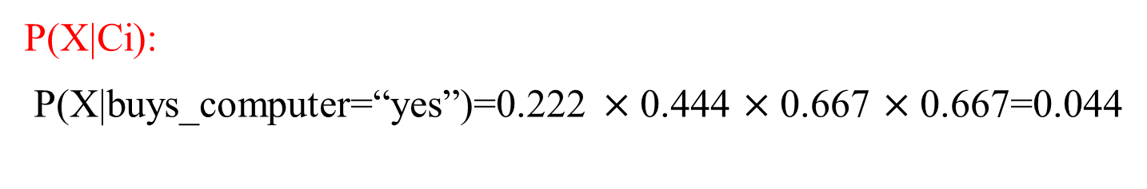
贝叶斯分类
X=(age<=30, income=medium, student=yes, credit_rating= fair)
P(X|Ci):
P(X|buys_computer=“yes”)=0.222 $×$0.444 $×$0.667 $×$0.667=0.044
Compute P(X|C_{i}) for each class
P(age = “<=30” | buys_computer = “yes”) = 2/9 = 0.222
P(income = “medium” | buys_computer = “yes”) = 4/9 = 0.444
P(student = “yes” | buys_computer = “yes) = 6/9 = 0.667
P(credit_rating = “fair” | buys_computer = “yes”) = 6/9 = 0.667

Slide 32
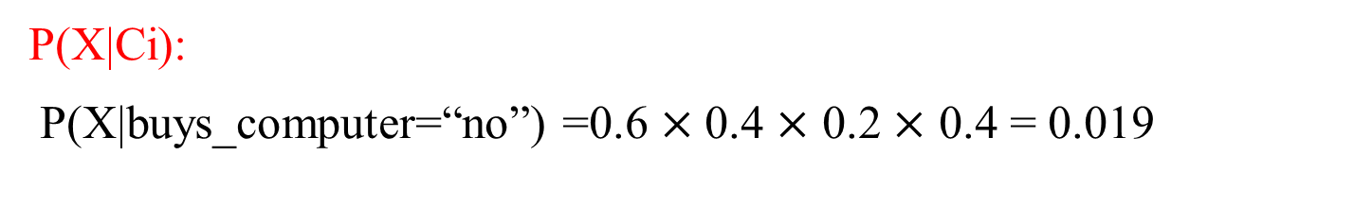
贝叶斯分类
X=(age<=30, income=medium, student=yes, credit_rating= fair)
P(X|Ci):
P(X|buys_computer=“no”) =0.6 $×$0.4 $×$ 0.2 $×$ 0.4 = 0.019
Compute P(X|C_{i}) for each class
P(age = “<= 30” | buys_computer = “no”) = 3/5 = 0.6
P(income = “medium” | buys_computer = “no”) = 2/5 = 0.4
P(student = “yes” | buys_computer = “no”) = 1/5 = 0.2
P(credit_rating = “fair” | buys_computer = “no”) = 2/5 = 0.4

Slide 33
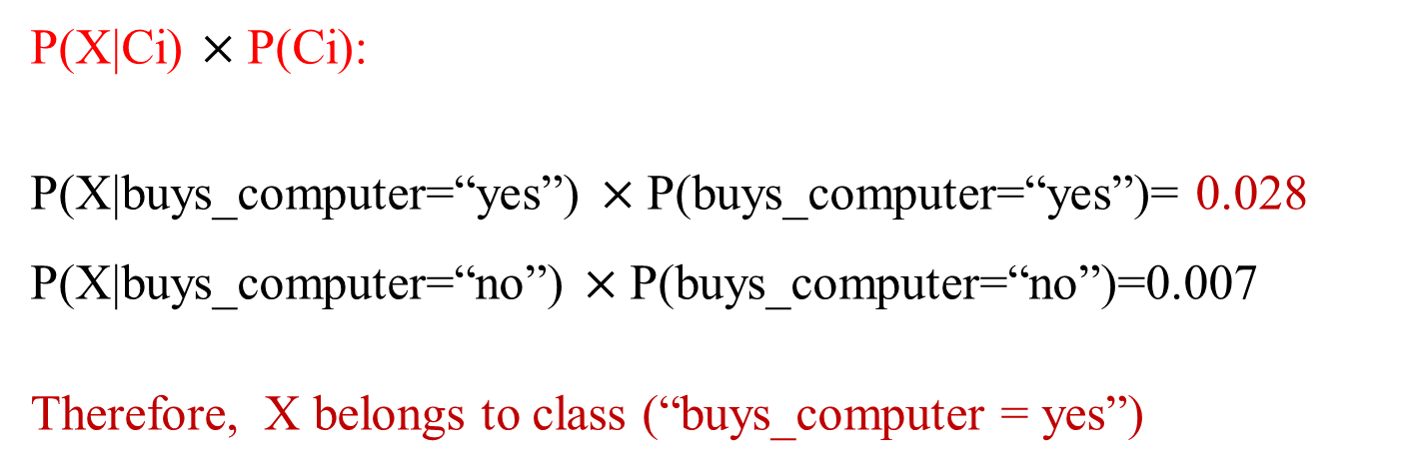
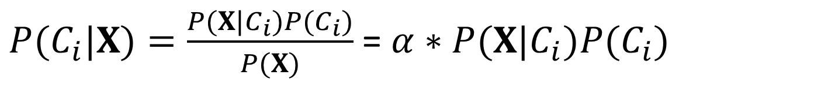
贝叶斯分类
X=(age<=30, income=medium, student=yes, credit_rating= fair)
$P(C_{i}|X)=\frac{P(X|C_{i})P(C_{i})}{P(X)}$ = $α∗P(X|C_{i})P(C_{i}{)}$
P(X|Ci) $×$P(Ci):
P(X|buys_computer=“yes”) $×$P(buys_computer=“yes”)= 0.028 P(X|buys_computer=“no”) $×$P(buys_computer=“no”)=0.007
Therefore, X belongs to class (“buys_computer = yes”)
√
(0.028, 0.007)
(80%, 20%)

Slide 34
贝叶斯分类
类 别:
C1: buys_computer = ‘yes’
C2: buys_computer = ‘no’
待预测数据：
X = (age>40,
Income = medium,
Student = yes,
Credit_rating = Fair)
预测X所属类别？
2021年12月28日星期二
Notes:
34

